Slide 1




Module Name - Conditionals, Loops & Functions
Class - Day 1
Topic Name- Conditional Statements and Loops
EditEdit MasterMaster texttext stylesstyles

Slide 2
Today’s Agenda
Introduction to Conditional Statements
if else Statement
else if Statement
Nested if else
switch Case Statement
Introduction to Loops

Slide 3
Today’s Agenda
for Loop
while Loop
do while Loop

Slide 4
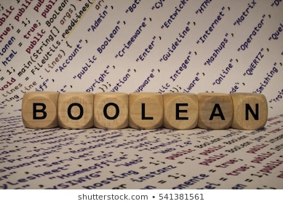
Introduction to Conditional Statements
You know that boolean statements are used in logical operations where the result of the statement are used to make further decisions.
Conditional Statements are referred to
those statements that have boolean value
that is either true or false.
Depending on the value of statement some specific course of action takes place.

Slide 5

Introduction to Conditional Statements
For example: Is it raining?
If yes: You have to take an umbrella.
If no: You don’t have to take an umbrella.
So, your decision to take an umbrella depends
on whether the condition that it is raining is
true or false.

Slide 6
Introduction to Conditional Statements
For example: Is the switch on?
If yes: the bulb glows.
If no: the bulb does not glow.
BULB GLOWS BULB DOES NOT GLOW
So again, glowing of bulb depends on whether the condition that switch is on is true or not.
SWITCH
BOARD
ON OFF

Slide 7
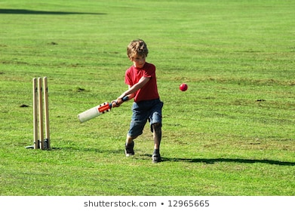
if else Condition
To represent such scenarios in programming world we use if else statements.In if else statements, else is optional. There might be situations where only if is enough.
For example: A mother does not want his
son to play cricket if he has not finished the
homework. There is no need for an else
condition here because if homework is
complete, then mother does not care whether he plays cricket or not.

Slide 8
if else Condition
if else Statement Pseudo Code
if(condition)
{
Action 1 // if the condition is true Action1 will be
} // performed
else
{
Action 2 // if the condition is not true Action 2 will
} // be performed

Slide 9


if else Condition
Like here,
if(switch is ON)
{
Bulb will glow
}
else
{
Bulb will not glow
}
Note: It is a pseudo code not an actual code

Slide 10

if else Condition
The general points to keep in mind are:
if else statements are used in those cases where only one out of the two code blocks needs to be executed
at any given point of time.
One of the condition and action is
mentioned in the if block.
The other condition & action are mentioned in the else block.

Slide 11
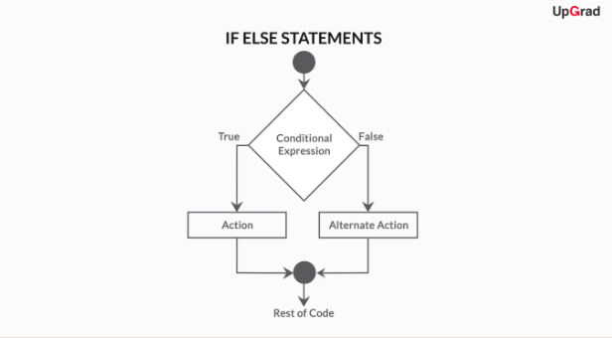
if else Condition

Slide 12
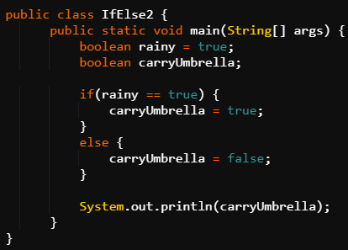
if else Condition
Example: Code to check whether to carry an umbrella or not depending upon the rainy conditions.
Java Code: if else

Slide 13

else if Statement
Now, you have seen how to check a condition and make a decision on the basis of whether that condition is true or not.
What if you want to check multiple conditions?
Is it possible?
Well, yes. This can be done using else if
statement.

Slide 14
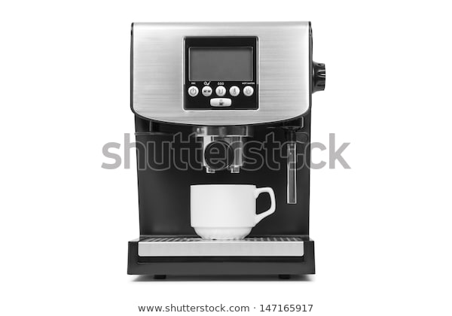
else if Statement
Suppose, you have to take coffee from a coffee machine. It has buttons which when pressed will give
Cappuccino, Espresso, Latte and Black
Coffee respectively.
Only if else statement won’t work here as that will only allow any two of the above four to be picked.

Slide 15
else if Statement
else if Statement Pseudocode
if(condition 1)
{ Action 1 } // Action 1 will take place if 1st
// condition is true
else if(condition 2)
{ Action 2 } // Action 2 will take place if 2nd
// condition is true
else if(condition n)
{ Action n } // Action n will take place if nth
// condition is true
else
{ Last Action } // If no condition is true

Slide 16
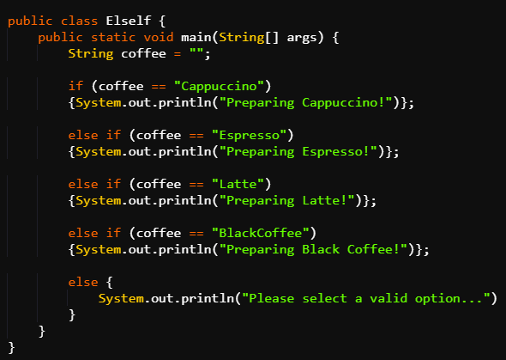
else if Statement
Example: Differentiating among coffees using else if.
Java Code Example: else if

Slide 17

else if Statement
There are four conditions for each type of coffee.
All these conditions in the bracket are checked
one by one in the order in which they are
written.
As soon as any one of the condition is true the
corresponding enclosed print statement will get executed.

Slide 18

else if Statement
The remaining conditions will not be
checked.
In case if all the conditions are false, then
the print statement enclosed in the else
block will get executed.

Slide 19
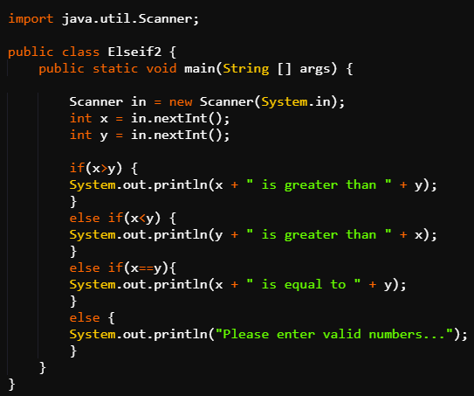
else if Statement
Example: Comparing values of two integers using else if.
Java Code Example: Else If

Slide 20

else if Statement
The input values x and y are taken as input from user.
There are three conditions where x and y are compared. All the conditions will be checked one by one.
As soon as any of the condition is true print
statement inside the respective block will be
executed.
If all are false, else block will be executed.

Slide 21
Nested if else
At times, you have to check sub-conditions within existing conditions. To do this there is a concept of Nested if else in Java.
Nested If Else basically means an If
Else statement inside another If Else statement.
{{{ }}}

Slide 22

Nested if else
Let’s say you’re going to a movie. First, you’ll check if the tickets are available at a theatre near your home.
Then, you will check another condition, i.e.
whether the price of the ticket is worth it.
However, if the tickets aren’t available, you
will not check this sub-condition.

Slide 23
Nested if else
TICKETS
YES NO
CAN’T BOOK
<400 >400
BOOK DON’T BOOK
PRICE

Slide 24
Nested if else
Pseudocode for this Example
if(Tickets Available)
{
if(price<400) // If tickets are available then price
// is checked
{ Book it } // If price is less than 400 ticket is
// booked
else
{ Don’t Book it } // If price is not less than 400
// ticket is not booked
}
else
{ Cannot Book it } // If tickets are not available

Slide 25
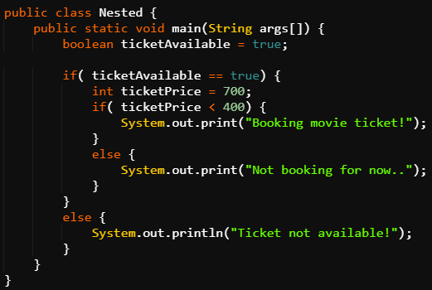
Nested if else
Java Code: Nested if else

Slide 26
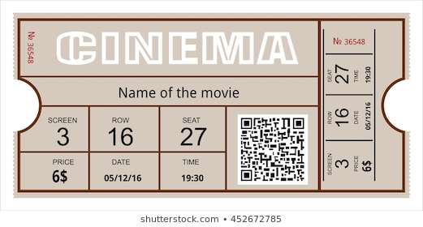
Nested if else
The value of boolean variable ticketAvailable is true.
So, value of variable ticketPrice will
be checked.
Since, value of ticketPrice is 700, so
“Not booking for now” will be printed which is present in the else block nested inside the if block of ticketAvailable condition.

Slide 27

Nested if else
Had it been less than 400 then “Booking movie ticket!” would have been printed which is present in the if block nested inside the if block of ticketAvailable condition.
If the value of boolean variable ticketAvailable
would have been false then “Ticket not
available” would have been printed which is
present in the else block.

Slide 28
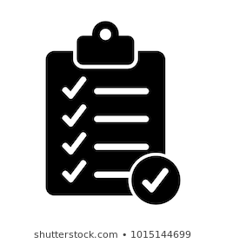
Switch Case Statement
There is another commonly used conditional operator called ‘Switch’.
It is used in switch case statements which are also
used when there are multiple conditions.
This statement can be seen as an alternative of
multiple if else statements.

Slide 29

Switch Case Statement
SWITCH CASE | IF ELSE
Switch case statements are strictly used only when you have to check the value of a variable and only then take an action. | It is recommended to use If Else statements in those situations where you might have to check some additional conditions besides the value of a single variable.
SWITCH IF
CASE ELSE

Slide 30

Switch Case Statement
Let us take an example to understand the switch case statement. Suppose, you have to write a program which allows the season to be guessed from the name of the month.
January -> Winter, …. July -> Monsoon...…
..November -> Autumn, December -> Winter
So you can take a String variable month and
then use switch case statements over it for different months.

Slide 31
Switch Case Statement
Pseudocode for switch case: month season Example
switch(month){
case “January”:
Print “Winter”
break;
case “July”:
Print “Monsoon”
break;
// If value of variable month is
// January, then this case will be // executed.
// If value of variable month is
// July,then this case will be
// executed.

Slide 32
Switch Case Statement
// If value of variable month is
// November, then this case will be
// executed.
// If value of variable month is
// December, then this case will be // executed.
// If value of variable
// month does not match with any of
// the cases then this default case // will be executed.
case “November”:
Print “Autumn”
break;
case “December”:
Print “Winter”
break;
default:
Print “Give valid value”
}

Slide 33
Switch Case Statement
All conditions are checked one by one. break statement is used so that once a condition is true then remaining conditions are not checked further.
Like in this case as soon as value of variable month matches the value in any of the case, the remaining cases will not be checked and only that block will execute.
If none of the conditions are met then the default block is executed.
Notes:
Coffee example can also be used to explain it further

Slide 34
Switch Case Statement
Switch case is advised to be used at places where the condition variable has some definite values.
Like, the month variable can have only 12 values and in all other cases default statement will be executed.
{ value 1, value 2,... value n }

Slide 35
Switch Case Statement
However, if else should be used when instead of definite values, range is defined for a variable.
[ . . . . ] min max

Slide 36
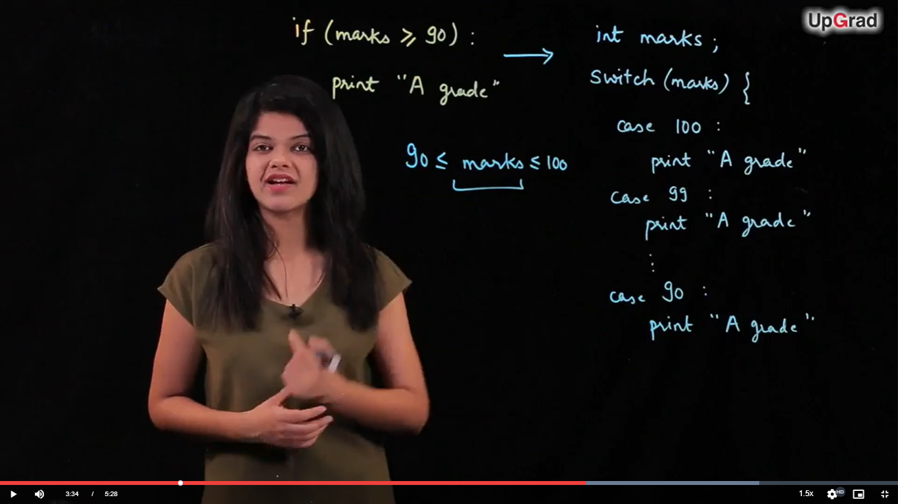
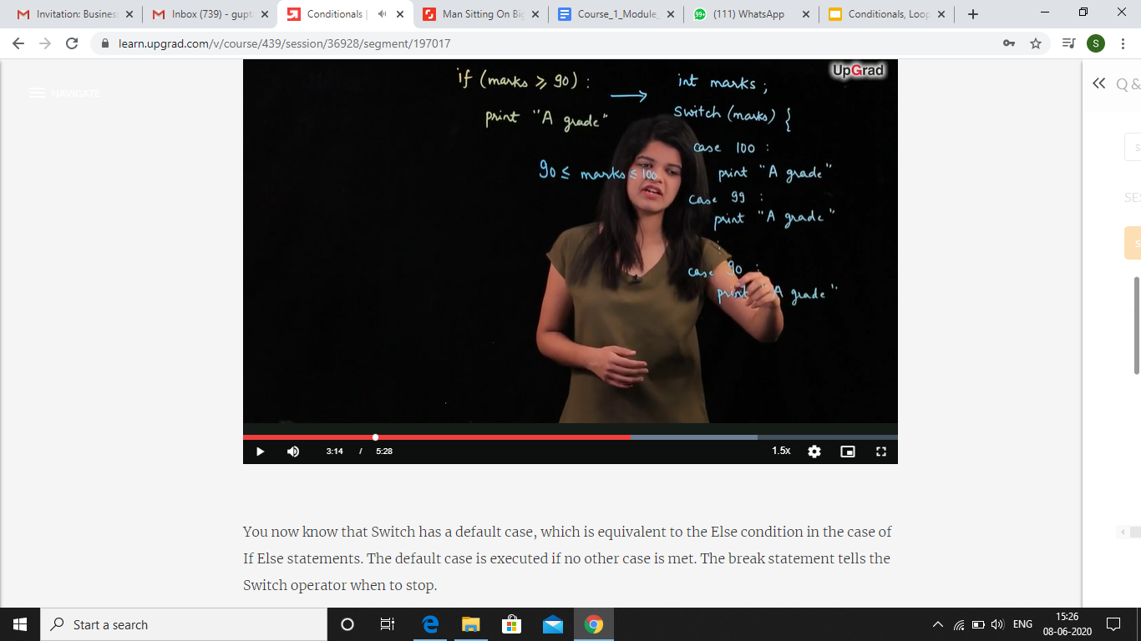
Switch Case Statement
Like here, the variable marks have a range of values from 90 to 100.
I
II

Slide 37
Switch Case Statement
I takes only two lines of code to write the complete logic using if. II takes a lot of lines to write the same logic using switch case.
And this was just one condition. If you were to give different grades to students having marks ranging from 0 to 100 then using switch case would have proved very hectic.

Slide 38
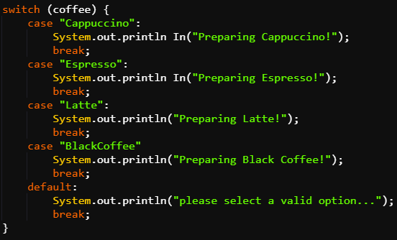
Switch Case Statement
Example: Coffee Machine Problem using Switch Case.
Java Code: Switch Case

Slide 39
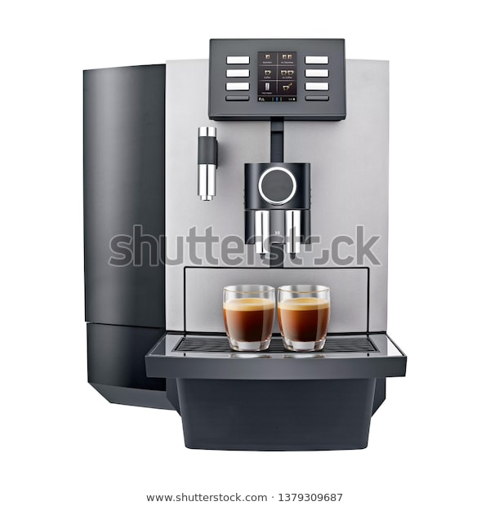
Switch Case Statement
coffee is a String variable which can have any value.
Suppose its value is Espresso, then it will print
“Preparing Espresso!” and will break out of this
switch case and will not check any other
condition.
Similarly if the value of coffee matches any other case, then the print statement in that block will be executed.

Slide 40


Switch Case Statement
And if its value does not match any of the case, then default case will be executed.
Now, suppose its value is Espresso and break
statements are not present, then first it will
print “Preparing Espresso!” and then execute
all the remaining cases including the default
case.

Slide 41

Introduction to Loops
You have seen how different conditions can be evaluated to make certain decisions using conditional statements. The if else and switch case statements were used to solve this purpose.
But what if you want to execute the same
condition multiple times?

Slide 42

Introduction to Loops
What if you need to repeat the same logic for multiple inputs? Do you write the same logic again and again to check each input?
This will be very hectic, time consuming and
also will make the code very lengthy.

Slide 43
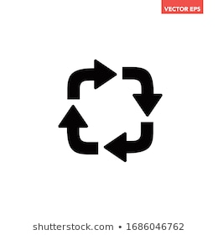
Introduction to Loops
Loops
So, Java has constructs called loops which can
facilitate repeated execution of a certain set of
statements until a certain user-defined conditions
is met.

Slide 44
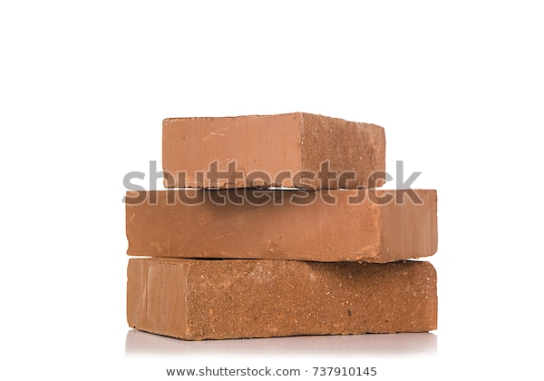

Introduction to Loops
Robot & Bricks Example
Let us say you are in a factory and assign a task to a robot to pick up some bricks and keep it somewhere else. Now if there are 100 bricks then instructing the robot
100 times would be hectic.
So, instruction must be given just
one time and should be repeated automatically in a loop while all the bricks are not moved.

Slide 45

Introduction to Loops
Printing of Even Numbers Example
Let us take another example. Suppose you are asked to print even numbers between 1 to 100.
Now, you won’t right print statements 50
times. Instead you’ll allow the computer
to check for even numbers between 1 to
100 and then print it.

Slide 46

Introduction to Loops
Pseudocode for Loops: Even Number Example
Check for all numbers between 1 to 100 starting from 1
if even: print
else: don’t print
Then move on to next number
// All the numbers were checked beginning
// from 1 and only the even numbers were printed. The // program remained in loop until 100th number was
// checked.

Slide 47
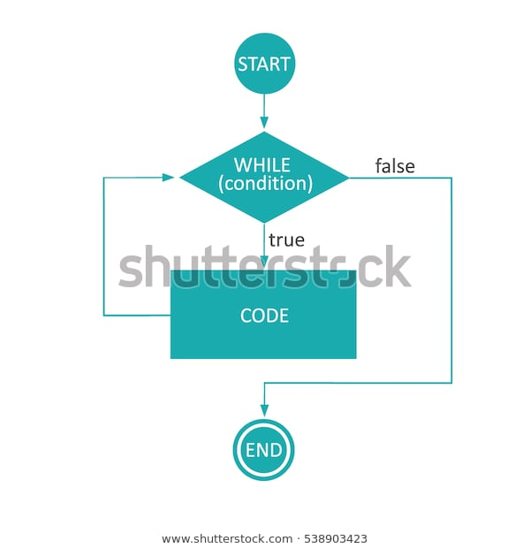
while Loop
Let us understand the pseudocode of bricks example using our first loop i.e while loop.
The concept that while loop holds is that
as long as the condition mentioned in the
loop is being satisfied it keeps on
repeating the logic. The program comes
out of the loop only when the condition
is failed.

Slide 48
Spot Test
Give the syntax of if else statement.
When is else if statement used?
What happens if break statement is not used in switch case statement?
Which statement should be preferred if the value of condition variable varies over a wide range?

Slide 49
while Loop
Pseudocode for while: Bricks Example
int bricks = 0;
while(bricks < 100) // loop will continue as long as
// this condition is satisfied
{
“Pick up brick”
“Keep it on wall”
bricks = bricks + 1; // value of bricks variable is
} // incremented by 1

Slide 50

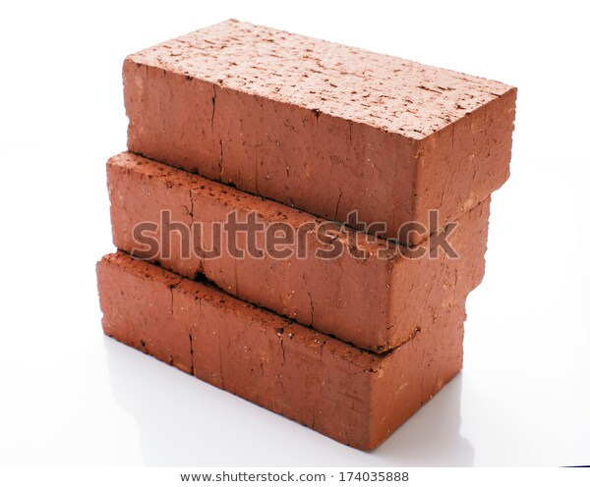
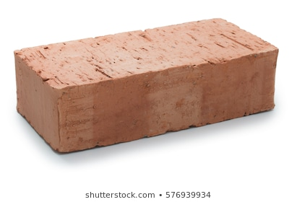
while Loop
Value of variable bricks is set to zero initially. It enters the loop.
Inside the loop there are 3 instructions. The first two instructions asks the robot to pick a brick and keep it on the wall.
The third instruction increments the value of brick variable by one.
=

Slide 51
while Loop
So now value becomes (0+1) i.e 1 and the same three instructions are repeated again in which the last instruction will again increase its value by 1.
When the value of variable brick reaches 100 the program comes out of the loop.
So the loop runs 100 times as value of brick changes from 0 to 99.

Slide 52
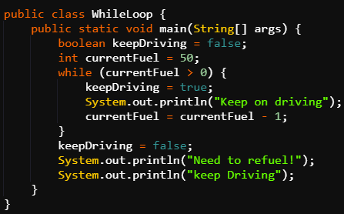
while Loop
Example: Code to show that car can be driven only if there is fuel left in the car.
Java Code: while Loop

Slide 53
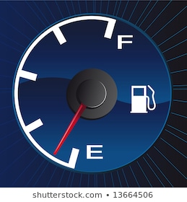
while Loop
This code allows the car to be driven if fuel is there and not driven if fuel is not there.
The initial value of currentFuel variable is taken as
50. The condition in while loop is that value of
currentFuel should be greater than zero.
So the program enters the loop, changes variable keepDriving to true, executes print statement and decrements currentFuel by 1.

Slide 54

while Loop
The program remains in the loop until the value of currentFuel reaches zero.
Value of keepDriving variable is
updated to false and a print
statement is made informing the
driver the need to refuel.

Slide 55
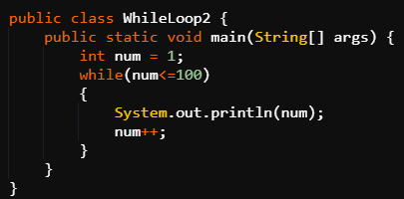
while Loop
Example: Code to print integers from 1 to 100.
Java Code: While Loop

Slide 56
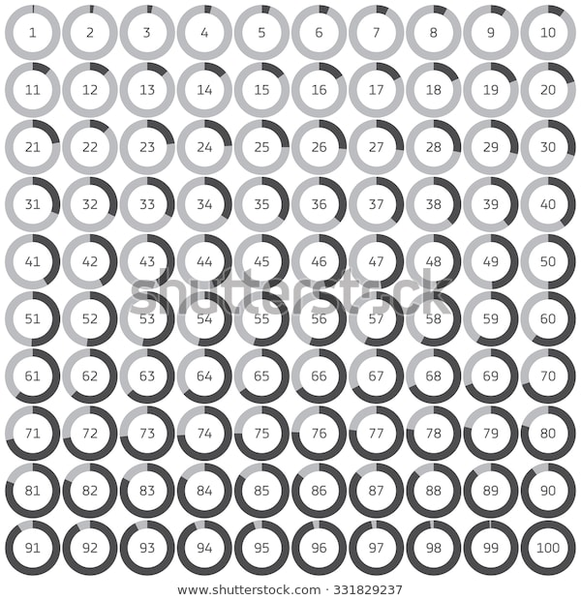
while Loop
The value of integer variable num is initialized to 1.
The condition in the while loop is that
num should be less than equal to 100.
So, program enters the loop, prints the
value of num and increments it’s value
by 1.

Slide 57
while Loop
As the value of num reaches 101, the program comes out of the loop.
If the instruction to increment num had not been given then the program would have remained in the loop and would have printed 1 infinite times.

Slide 58
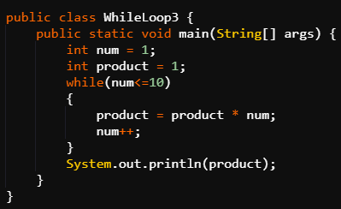
while Loop
Example: Code to print the product of first 10 natural numbers.
Java Code: While Loop

Slide 59
while Loop
Integer variables product and num are initialized to 1.
The program enters the while loop. Value of product gets updated each time the loop runs.
It is multiplied with num and then the value is stored in product itself.

Slide 60
while Loop
num is incremented by 1 in each iteration so that product is multiplied to every natural number from 1 to 10.
This way when the value of num reaches 11, the program comes out of the loop and the value of product variable equals to the product of first 10 natural numbers.
Then value of product is printed.

Slide 61
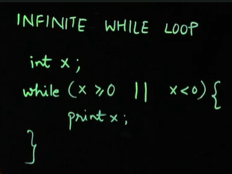
Infinite while Loop
Infinite while Loop: Example

Slide 62

Infinite while Loop
Infinite while loop condition can also occur when the condition of the loop remains satisfied forever.
Like in this code, the condition is that the
value of variable x should be either
greater than equal to zero or less than
zero which is true for all values of x.
So, value of x will be printed infinite number of times.

Slide 63

for Loop
Let us now look at another kind of loop, the for loop.
Syntax
for(__;__;__;)
{
code...
}

Slide 64
for Loop
Initialization of the variable is done here __
For eg: int i=0 // value of i is 0 initially.
Condition for the loop is given here __
For eg: i<10 // Program will be in loop as long as
// this condition remains satisfied
Increment/Decrement is done here __
For eg: i++ // This will increment the value of i by 1

Slide 65
for Loop
Printing Even Numbers Example
Suppose, you have to print only even numbers present in between 1 to 100.
So, Check for all numbers between [1 -100]
If even -> Print
Else -> Do not print
Move on to next number

Slide 66
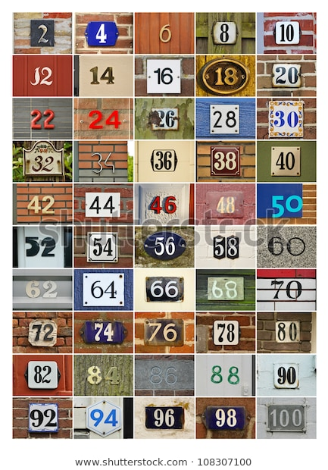
for Loop
Java Code for the for loop: Even Number Example
for( int i=1; i<=100; i++ ) {
if( i%2 == 0 )
{
System.out.print( i );
}
}

Slide 67
for Loop
Value of integer variable i is initialized to 1. It’s value should be less than equal to 100 for the loop to remain executed.
Value of i will be incremented in every iteration of the for loop. No need to mention it inside curly braces again.
if statement is present inside curly braces which checks for even number by using the mod operator and then prints it.

Slide 68
for Loop
If value of mod of i is zero then it means that there is no remainder thereby number is divisible by 2 and hence even otherwise there will be no printing.
So, the loop checks for each value of i from 1 to 100 and as soon as the value reaches 101, the loop ends.

Slide 69
while Loop v/s for Loop
while Loop | for Loop
Initialization & Declaration of i was done before the starting of the loop. | Initialization & Declaration of i was done inside for condition.
Incrementation was done inside curly braces in the end. | Incrementation was done inside for condition which automatically meant that i will be incremented after every iteration.

Slide 70

while Loop vs for Loop
So, you have seen the basic differences between a for and a while loop. However, both the loops are equally good to use. None of the loop is better than the other.
Both the loops are interchangeable but,
at times there are situations when you
prefer to use either the for loop or the while loop.

Slide 71


while Loop vs for Loop
Consider an example where you have to fill a bucket with water using a mug but you don’t know the exact volume of the bucket as well as the mug.
So, basically you do not know the
number of times you will have to use
the mug to fill the bucket.

Slide 72
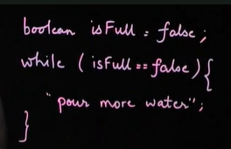
while Loop vs for Loop
So, if you’ll use a for loop, you won’t have a mathematical condition to stop the for loop as you do not know the number of iterations.
You just only have one stopping
condition which is that the water
should be poured while the bucket is
not full. So, while loop should be
preferred here.

Slide 73

while Loop vs for Loop
It is a good practice to use while loop when the number of iterations are not known initially.
For loop should be used if iterations
are known and mathematical
conditions are required. Like, i<300.
Comparison conditions like x>y should be preferred to be done using while loop.
FOR WHILE

Slide 74
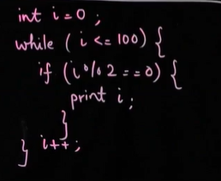
while Loop v/s for Loop
Example: Code to print even numbers between 1 to 100
Even Numbers Example using while Loop

Slide 75
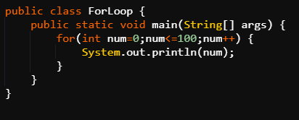
for Loop: Examples
Example 1: Code to print first 100 whole numbers.
Java Code: For Loop

Slide 76
for Loop: Examples
Integer variable num is initialized to 0.
Condition for loop execution is that it’s
value should be less than equal to 100.
num is incremented by 1 in each iteration.
<=100

Slide 77
for Loop: Examples
A print statement is made inside the loop where the value of num is printed.
So, as num varies from 1 to 100 , print statements are being made to print integers from 1 to 100.
The loop stops as soon as the value of num becomes 101.

Slide 78
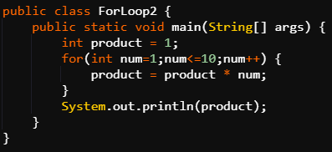
for Loop: Examples
Example 2: Code to print the product of first 10 natural numbers.
Java Code: For Loop

Slide 79

for Loop: Examples
Integer variables product and num are initialized to 1. num is initialized inside for condition whereas product is initialised before the loop.
Value of product gets updated each
time the loop runs. It is multiplied with
num and then the value is stored in
product itself.

Slide 80
for Loop: Examples
num++ inside the for loop condition allows num to get incremented by 1 in each iteration so that product is multiplied to every natural number from 1 to 10.
This way when the value of num reaches 11, the program comes out of the loop and the value of product variable equals to the product of first 10 natural numbers.
Then value of product is printed.

Slide 81

do while Loop
do while Loop
It is similar to while loop. However, it gets executed at least once irrespective of whether the condition of
the loop is met or not.
In do while loop, the statements of the loop
are executed first and condition is checked
after that which is contrary to the while loop.

Slide 82
do while Loop
Syntax
do{
Code statements…
}
while( condition )
First the red block will be executed and then the condition will be checked.
If the condition is satisfied then it will be iterated again and the statements will be again executed.
Then, this will go on until the condition becomes false.

Slide 83
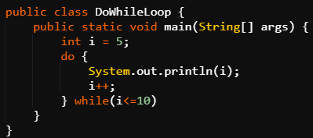
do while Loop
Example: Code to print integers from 5 to 10.
Java Code: Do While Loop

Slide 84
do while Loop
In the first iteration, 5 will be printed, value of integer variable i will be incremented and then the condition (i<=10) will be checked.
The condition will be satisfied as value of i is now 6 and iteration will take place again.

Slide 85
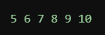
do while Loop
In the last iteration 10 will be printed, value of i will become 11 therefore condition will not be met and hence loop will end.
Even if the condition had not been satisfied the first time, like suppose it was ( i <= 4), then also 5 would have been printed as condition is always checked in the end.

Slide 86

Thank you!
#LifeKoKaroLift

